Slide 1
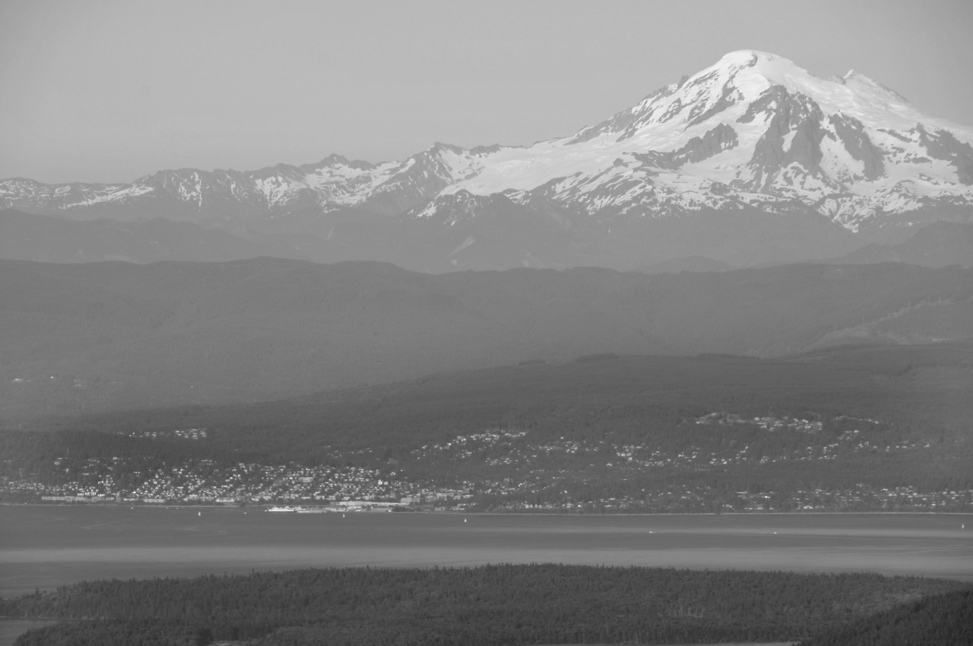
Energy Audit Grant Program
First Steps and Information Gathering

Slide 2
Background
2019
Clean Buildings Act
2022
Expansion to include Tier 2 Buildings
2024
WSAC proviso for Energy Audit grants

Slide 3
Clean Building Performance Standard
Buildings over 50k sq. ft.
An energy performance standard
Buildings over 20k sq. ft.
Energy Management Planning (EMP)
Compliance Process
Operations and Maintenance (O&M)
Tracking energy use over time

Slide 4
Clean Building Performance Standard
Benchmark
Establish your buildings performance metric
Integrate your building into the Energy Star Management Portfolio
Planning
Create Energy Management Plan
Create Operations and Maintenance Plan
Compliance
Meet and Energy Use Intensity target (EUIt)
Utilize the Investment Criteria
Determine Compliance Path

Slide 5
Clean Building Performance Standard
June 2026
Buildings over 220k sq. ft.
June 2027
Buildings over 90k sq. ft.
July 2027
Tier 2 benchmarking and planning completed
Buildings over 50k sq. ft.
June 2028

Slide 6
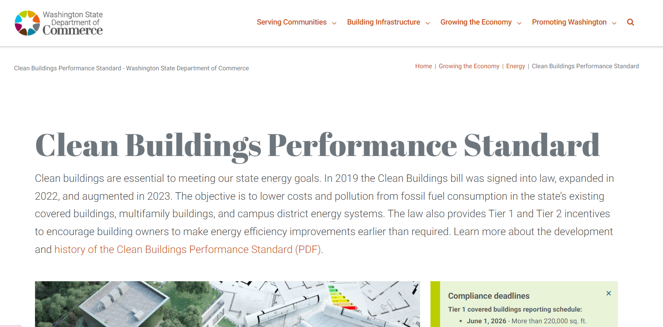
Clean Building Performance Standard
https://www.commerce.wa.gov/growing-the-economy/energy/buildings/

Slide 7
WSAC Energy Audit Grants
(4) $4,000,000 of the appropriation in this section is provided solely for the Washington state association of counties to provide funding for energy audits on county-owned tier 1 and tier 2 covered buildings and collect and manage data on the costs for counties to comply with the requirements of RCW 19.27A.210 and 19.27A.250.
(a) The Washington state association of counties may award grants to counties with qualifying buildings to assess current energy performance and determine the approximate costs of facility and system upgrades to meet state energy performance standards in chapter19.27A RCW.
(b) The Washington state association of counties shall submit to the appropriate committees of the legislature no later than December 31, 2025, a report detailing the current energy performance of each county-owned tier 1 and tier 2 building for which an energy audit was completed with the funding provided in this subsection (4), and an estimate of the costs for bringing each building into compliance with the state energy performance standards in chapter 19.27 RCW.

Slide 8
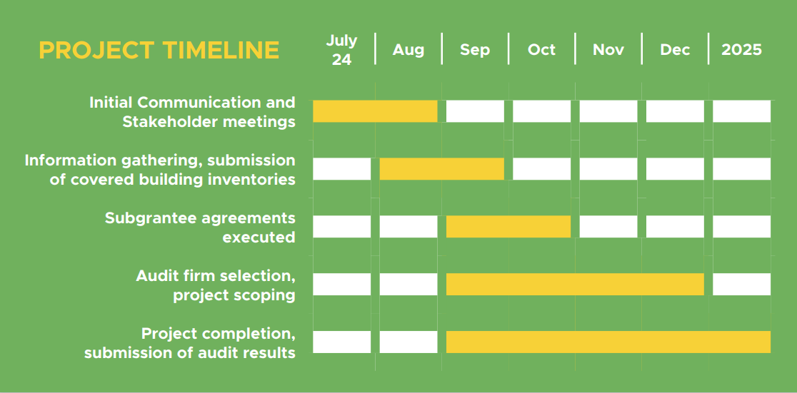
WSAC Energy Audit Grants

Slide 9
WSAC Energy Audit Grants
Data needed for each covered building
Address
Parcel Number
General Description
Use
Square footage
Building age
Date of last renovation
Date of last energy audit (if applicable)
Exemption Status

Slide 10
WSAC Energy Audit Grants
Data needed post audit or for recently audited buildings
Compliance pathway
Performance metric
Cost of Audit
Cost of completing EMP and O&M
Estimated ongoing cost of tracking and O&M activities
Rough order of magnitude (ROM) cost of achieving compliance with CBPS

Slide 11
WSAC Energy Audit Grants
Requests for funds must specify budget needs by building, audit level, and activity type.
Application can be submitted via Jotform, link will be available by mid-August
Contract may be executed starting September 1st and may be backdated to July 1st, 2024
Grants will operate on a reimbursement basis

Slide 12
WSAC Energy Audit Grants
Allowable expenses include:
Staff time needed to report data to WSAC and assess current energy performance
Costs associated with procuring energy audit services from a qualified energy audit firm and conducting level 1, 2 or 3 audits on covered buildings.

Slide 13
WSAC Energy Audit Grants
Reporting Requirements:
WSAC must compile and submit quarterly progress reports to Commerce starting October, 2024
Upon completion of audits grantees must update their covered building inventory

Slide 14
Resources
Commerce Support and Resources page: https://www.commerce.wa.gov/growing-the-economy/energy/buildings/support-and-resources/
DES Energy Savings Performance Contracting https://des.wa.gov/services/facilities-and-leasing-management/energy-program/energy-savings-performance-contracting-espc

Slide 15
Curtis Steinhauer
Policy Analyst
360.580.2301
CSteinhauer@wsac.org
206 10th Ave SE, Olympia, WA 98501-1311
/wacounties
360.753.1886
@wacounties
www.wsac.org
@wacounties

